Slide 1
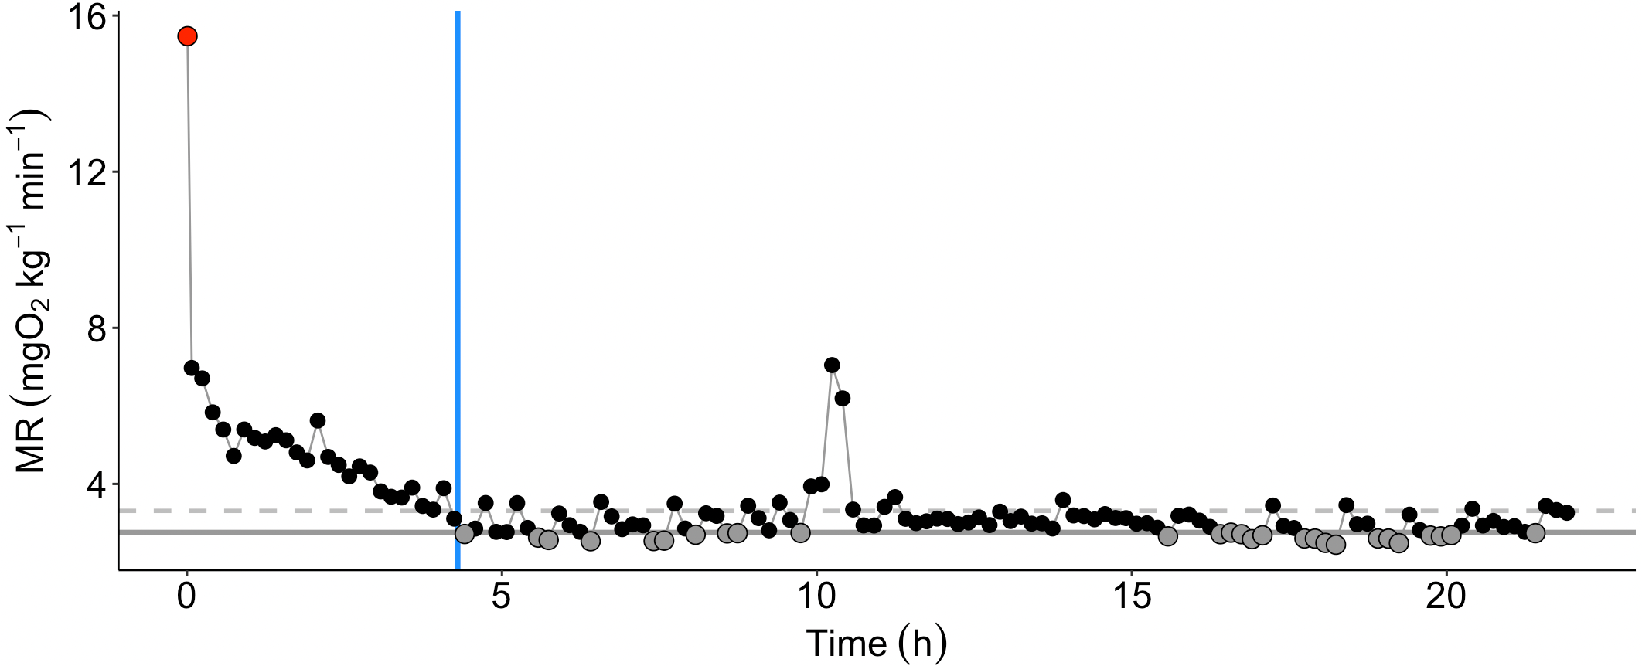
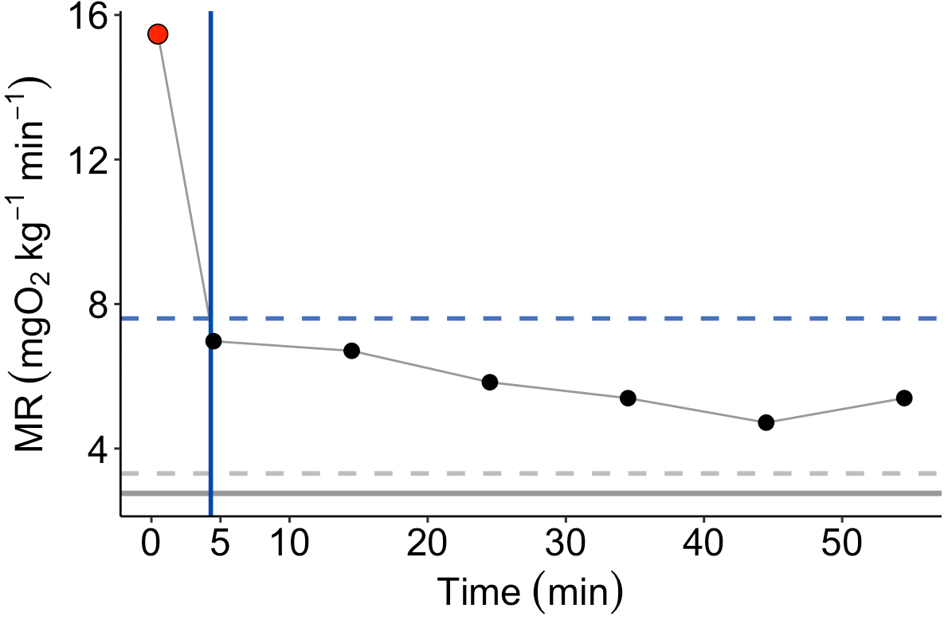

Full respirometry trial
MMR
Time to EPOC
Where MR values reached 20% above SMR
Adjustable smoothing function
EPOC
SMR
Mean of values in grey (20th percentile)
epoc_threshold = 1.2
epoc_threshold = 1 (default)
Legend
First hour
Oxygen consumption rate value
Time to 50 % MMR
Values in the lowest 20th quantile
Where MR values reached 50% of MO₂ at time 0
MMR = maximum metabolic rate
recovMMR_threshold = 0.5 (50% = default)
SMR = standard metabolic rate
20% above SMR
50 % MMR
EPOC
= excess post exercise oxygen
consumption

Slide 2
SMR / ‘AUTO’-CONTROL
Open phase
(flush)
10 min
Closed phase (measurement)
5 min
Full measurement cycle 15 min
Oxygen
[% AS, mg/L, mmol, etc]
0
10
15
25
30
Excluding 10 seconds from the start and end of each measurement
Start with flush
Closed phase begins
Closed phase ends
SMR(cycle_start = 10, …)
SMR(cycle_start = 10,
cycle_end = 15, …)
SMR(cycle_start = 10,
cycle_end = 15,
chop_start = 10/60,
chop_end = 10/60, …)
Relative time (min)

Slide 3

MMR / ‘MANUAL’ CONTROL
SMR / ‘AUTO’-CONTROL
ID1
Ch1
Undisturbed state
MMR
2nd cycle
3rd cycle
4th cycle
(1st cycle)
Ch1=1
ID2
Ch2
Undisturbed state
MMR
3rd cycle
4th cycle
(2nd cycle)
Ch2=2
ID3
Ch3
Undisturbed state
MMR
4th cycle
(3rd cycle)
Ch3=3
ID4
Ch4
Undisturbed state
MMR
Stop MMR file
Stop MMR file
(4th cycle)
Start SMR file
Stop SMR file
Ch4=4
min
0 4.5 11 15.6 22.1 26.2 31 35
0 10 15 25 30
… Overnight
cycle_start
cycle_end
cycle_start
cycle_end
cycle_start
cycle_end
cycle_start
cycle_end
SMR(cycle_start = 10, cycle_end = 15)
MMR(…, cycles = 4, cycle_start = c(0,11, 22.1, 31),cycle_end = c(4.5,15.6, 26.2, 35), mmr_Ch1 = 1, mmr_Ch2 = 2, mmr_Ch3 = 3, mmr_Ch4 = 4)

Slide 4
Underscore or can be a dash
Can be anything
jul04_2019_box1_fishfile1_smr
Three letter + 2-number day of the month
4-number year
“box” and 1-number Nº
The name is NOT case sensitive. The upper/lower case does not matter it can be Box, BOX, box, and for date, it may be Jul, JUL, jun, ...)
* Green part: can be anything by authors choice.

Slide 5
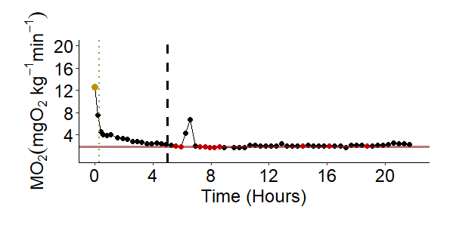
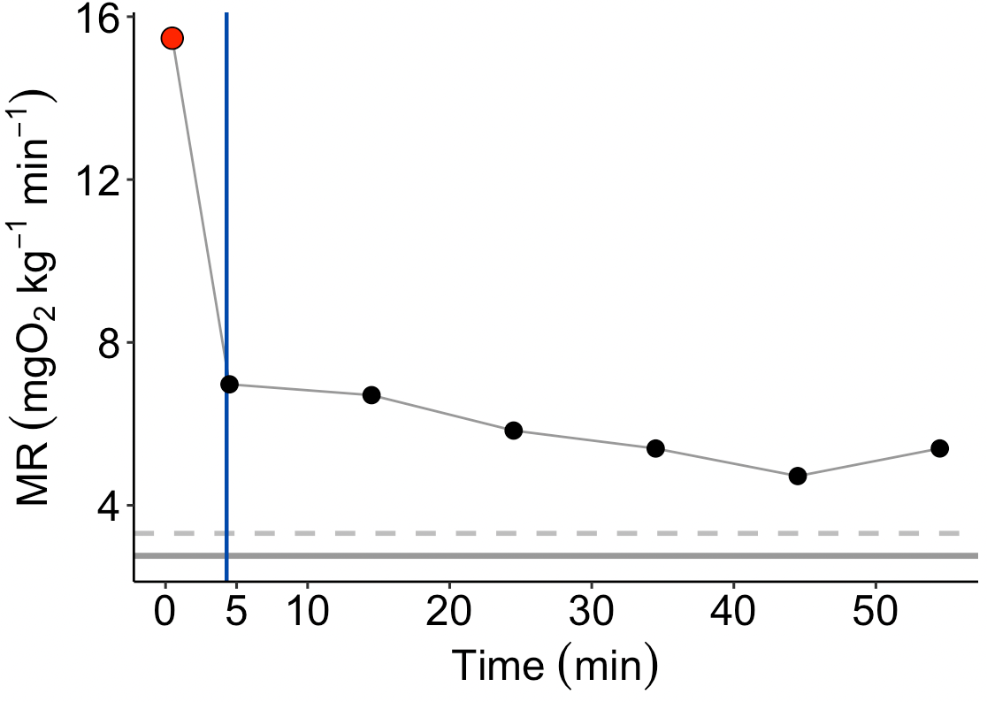
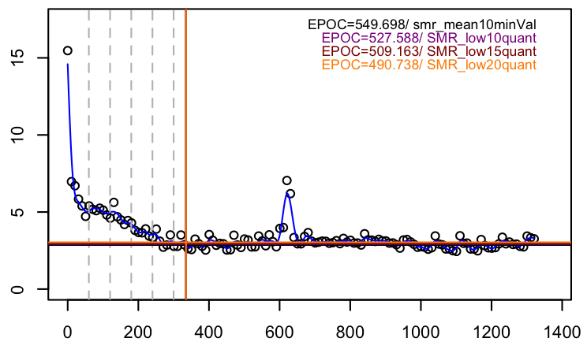
20%
SMR
RMR
MMR
EPOC
SMR

Slide 7
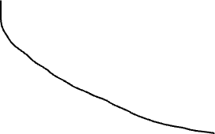

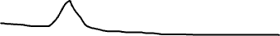
MMR
end_EPOC_Ch
Aerobic scope =
MMR - SMR
50 % MMR
Metabolic Rate
EPOC = area under the curve
epoc_threshold
20% SMR or RMR
SMR level
Time to EPOC
Relative time (min)
Time to EPOC, manually assigned

Slide 8
Spar 0.1
Spar 0.2
Spar 0.4
Spar 0.6
Spar 0.8
Spar 1.0
Spar 0.3
Spar 0.5
Spar0.7
Spar 0.9

Slide 9
A
Full respirometry trial
MMR
Time to EPOC
Where MR values reached 20% above SMR
RMR
Mean of all values after Time to EPOC
SMR
Mean of all MR values in grey
B
First hour
Legend
Time to 50 % MMR
Oxygen consumption rate value
Where MR values reached 50% of MO₂ at time 0
Values in the lowest 20th quantile.
MMR = maximum metabolic rate
50 % MMR
SMR = standard metabolic rate
20% above SMR
EPOC
= excess post exercise oxygen
consumption

